Slide 1


01
Voting System using 2-SAT Problem
PRANJAL SINGLA 2K20/IT/102
UTKARSH PANDEY 2K20/IT/155
Submitted to : Dr. Jasraj Meena

Slide 2

WHAT IS SATISFIABILITY?
02
Satisfiability is one of the most elementary parts of Formal Logic. A formula or statement is said to be Satisfiable if there exists at least one such model wherein the given statement holds true. This is in sharp contrast to Validity where a statement is only valid if the statement holds true for all the models or interpretations.
WHAT IS THE BOOLEAN SATISFIABILITY PROBLEM?
Also known as the K-Sat problem, The Boolean Satisfiability Problem aims to find a model or interpretation for a set of given statements such that the resultant is satisfiable. In other words, the system aims to find a set of values for the variables such that the given statement becomes true.
While the solution for this problem seems very intuitive to the human mind for smaller values, as the number of variables increases, the complexity shoots up exponentially, making the resolution highly complex.

Slide 3




UNDERSTANDING K-SAT WITH AN EXAMPLE
Let’s say we have a small city with around a million families, and we want to release a new development plan for the people. Now, this plan may include variables like, making a spare patch of land a concert ground. Now, there may be some people who would love a new concert ground while others who are strictly against the same. Similarly, let’s say there are m options for the people.
Such a situation can be modelled in terms in terms of a Conjunctive Normal Form (CNF):

Slide 4
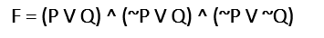
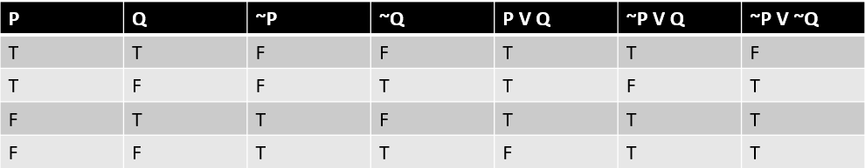
A SIMPLE 2-SAT PROBLEM
04
Suppose you want to find the satisfiability of this expression, we create a truth table
THIS PROBLEM IS SATISFIABLE AT P = FALSE AND Q = TRUE

Slide 5
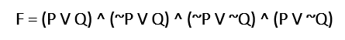
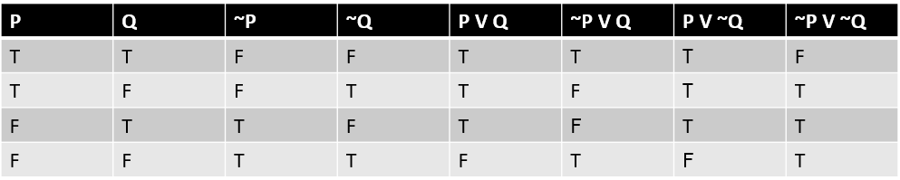
ANOTHER EXAMPLE
05
Suppose you want to find the satisfiability of this expression, we create a truth table
THIS PROBLEM IS NOT SATISFIABLE

Slide 6
GRAPHS
06
A Graph is a non-linear data structure, and consists of a finite set of nodes or vertices. Graphs are further divided into Directed, Non-Directed, Weighted, Non-Weighted Graphs depending upon the type of edges incorporated in the structure.
DIRECTED GRAPH
TRANSPOSE OF A GRAPH
When a graph has an ordered pair of vertices, it is called a directed graph. The edges of the graph represent a specific direction from one vertex to another. When there is an edge representation as u → v, the direction is from u to v. The first element u is the initial node or the start vertex. The second element v is the terminal node or the end vertex.
Transpose of a directed graph G is another directed graph on the same set of vertices with all of the edges reversed compared to the orientation of the corresponding edges in G. That is:
If G contained an edge u → v , then the Transpose G’ will contain an edge v → u , and vice versa.

Slide 7
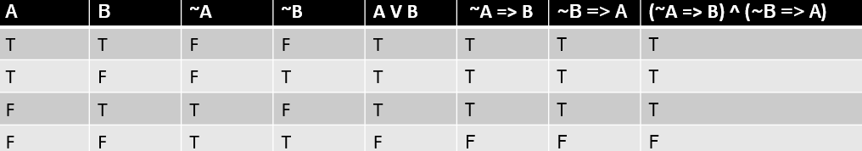
WHY ARE WE USING GRAPHS?
07
For the CNF value to come TRUE, value of every clause should be TRUE. Let one of the clause be A V B.
For this to be true, either:
If A = 0, B must be 1
If B = 0, A must be 1
The CNF obtained above can be converted into an Implication Graph which then translates into a Directed Graph using the following way:
A ∨ B ≡ (~A⇒B) ^ (~B⇒A)
Here, we can see that there is a directed edge from B to A and from A to B which in turn forms our directed graph.

Slide 8
HOW ARE GRAPHS BEING USED?
08
We say that if any option xi and it’s conjugate xi lie in the same Strongly Connected Components (SCC) then the problem is Unsolvable meaning that we cannot find such an arrangement of the assignment of variables such that the following expression comes out to be true while also satisfying the constraints.
Now in real life ‘Unsolvable’ doesn’t make any sense but what it translates into is that there will be certain families who do not get their required choice in the final distribution, but for the sake of simplicity we have declared it as ‘Unsolvable’.
We are finding SCC’s using the classical Kosaraju’s Algorithm and then assigning each node it’s SCC number. This is done by constructing a normal and transpose graph simultaneously. We run one DFS on the normal graph and add elements into the stack in the reverse order. We then traverse each element in the stack and run a DFS on the transpose graph which numbering vertices according to their SCC number. Finally, based on the SCC numbers of a variable and its conjugate, we assign the values in our final distribution.
Thus, we reduce the time complexity from O( 2mn) to O (n+m) which for at least for 1e6 can run in under 1 second for state-of-the-art applications.

Slide 9
METHODOLOGY
09
Handling the negative nodes
For the problem at hand, since any family can possibly enter information like:
+7 -2, we would need to somehow store -2 as a node in our adjacency list.
This is not possible as the indexing in our array by convention starts from 0, hence we came up with an alternative approach to address this issue, we are storing 2 nodes for every absolute value of number entered. Formally:
For every node m we are inserting:
2m for m,
2m+1 for -m.
Doing this, we essentially store all the positive nodes in even numbers, i.e. as 2m, while the negative nodes are stored in odd numbers, i.e. 2m+1, thus solving the issue of negative nodes.

Slide 10
Depth First Search
As the name suggests, DFS is a form of Graph traversal wherein we explore the depths of the graph from a given node first.
Depth first traversal or Depth First Search is a recursive algorithm for searching all the vertices of a graph or tree data structure. We start from a node and visit one of its neighbors and so on recursively till we visit all the nodes of the source. The time complexity of such a traversal is O( n+m ), where n is the number of nodes and m is the number of edges.
Topological Order
A topological sort or topological ordering of a directed graph is a linear ordering of its vertices such that for every directed edge u → v from vertex u to vertex v, u comes before v in the ordering. For instance, the vertices of the graph may represent tasks to be performed, and the edges may represent constraints that one task must be performed before another; in this application, a topological ordering is just a valid sequence for the tasks. A topological ordering is possible if and only if the graph has no directed cycles, that is, if it is a directed acyclic graph (DAG).
The Topological Ordering of the graph prints the vertices in order of their decreasing departure time calculated with the help of a DFS.
10

Slide 11
11
Departure Time
The Departure Time for each vertex is defined as the time when the DFS last backtracks to that vertex during a traversal.
Strongly Connected Components (SCC)
A graph is said to be strongly connected if every vertex is reachable from every other vertex. The strongly connected components of an arbitrary directed graph form a partition into subgraphs that are themselves strongly connected.
Kosaraju’s Algorithm
The Kosaraju algorithm is a DFS based algorithm used to find Strongly Connected Components (SCC) in a graph. It is based on the idea that if one is able to reach a vertex v starting from vertex u, then one should be able to reach vertex u starting from vertex v and if such is the case, one can say that vertices u and v are strongly connected - they are in a strongly connected subgraph.

Slide 12
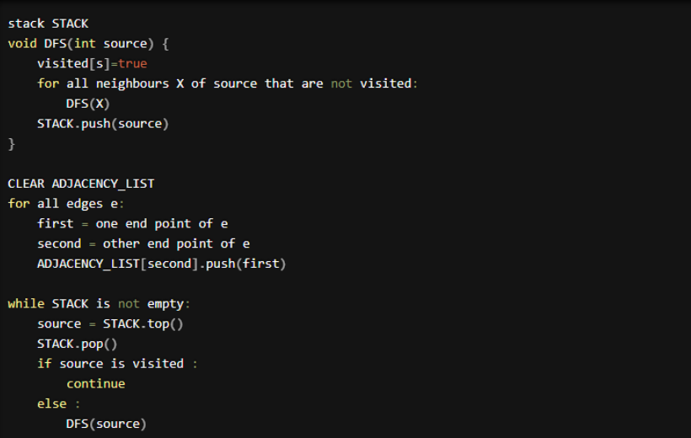

Slide 13


IMPLEMENTATION
We used the solving approach to the 2-SAT problem, using Graphs and Satisfiability, and tried to modify it to make a potentially better and fair voting system. In the current paradigm, voting mainly follows a majority vote approach, leaving the wishes of those in a minority unaddressed. The model we have come up with, takes the input number of choices for the people, the number of entities participating in the voting, and their respective preferences with regard to the choices provided. After taking this input, the program maximizes the number of priorities met, while maintaining that at least one of the preferences of all are accepted and worked upon if possible. In a case where such an arrangement is not possible, we keep note of the entities whose preferences were not met, and the governing body can then go ahead and release compensation for them.

Slide 14
PROCEDURE
14
We employ all the above-mentioned techniques to obtain an answer which would be best explained with the help of an example.
Let n, the number of families be 3,
and let m be the number choices which are 5 for this example
let n choices be of the form:
+ 1 + 2
- 1 + 3
+ 4 – 2
Where + means to include a certain choice and – means to exclude a certain choice.
This is essentially a Conjunctive Normal Form which can be converted into a Directed Graph:
-3
2
3
-2
-1
4
1
-4

Slide 15
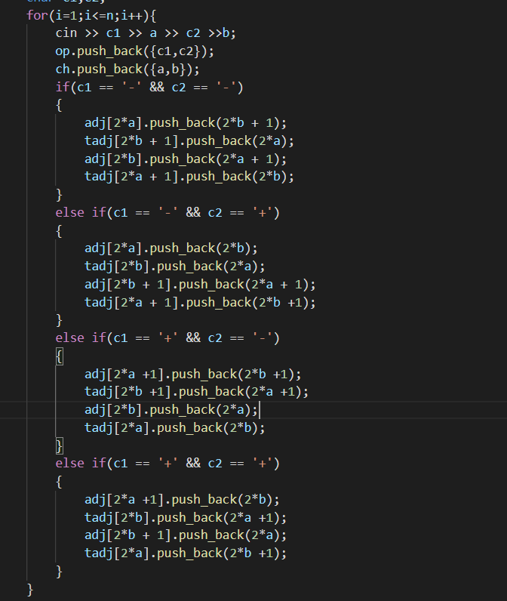
Step 1 : Input is +1 +2
In the normal graph , connect 3 -> 4
In the transpose graph connect 4 ->3
In the normal graph, connect 5-> 2
In the transpose graph, connect 2->5
Step 2: Input is -1 +3
In the normal graph , connect 2->6
In the transpose graph connect 6->2
In the normal graph, connect 7->3
In the transpose graph, connect 3->7
Step 3 : Input is +4 -2
In the normal graph , connect 9->5
In the transpose graph connect 5->9
In the normal graph, connect 4->8
In the transpose graph, connect 8->4
Therefore the graph is:
7->3->4->8
9->5->2->6
15

Slide 16
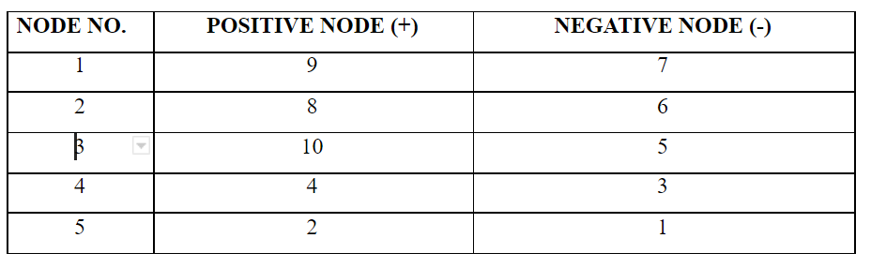
By scaling the nodes to avoid Negative values, we get:
16
7
4
6
5
3
8
2
9
11
10
Nodes 10, 11 are not picked by any family and hence are unused. Now marking All the SCC Numbers of the nodes:

Slide 17
17
Now for the most important part. If we take the above graph or any Directed Graph and represent each Strongly Connected Component by a single node, we get a Directed Acyclic Graph (DAG). Due to the manner Kosaraju’s Algorithm is applied the resulting condensation graph with each SCC number is obtained in topological order.
Since topological order is actually like a dependency order, hence we experimented with the SCC number of the positive and negative values of a certain node and we found out that:
If SCC[a] > SCC[-a], it is better to include the specific node in our final distribution, else we do not include this node in our final distribution.
We just need to set a value to an element there (the first component in topological order) and propagate it (according to the logical implication operation and to the fact that if a = True you must set -a = False). If we try to propagate to an element that already has a true or false value (and it doesn't clash with the one we’re trying to set) we can simply skip it, because it means we’ve already propagated from it.

Slide 18
TIME COMPLEXITY
18
Through this project, we have managed to reduce the time complexity of such tasks from O (2^mn) to O( n+m ), which is a huge improvement.
Original time complexity, derived from the brute force approach, becomes exponential. Consider the 2 given options for all m choices, which makes the total number of possible priority arrangements 2^m. Now, since we have to make a total of n iterations for all n entities, checking to see if their priorities are met, we come to the expression (2^mn).
On the other hand, in our case, since we are doing a DFS call on a graph built by modelling these choices, entities and priorities, we can solve the same problem in O( n+m ).

Slide 19

Let's look at the code now!

Slide 20


